Slide 1
Dependency Inversion Principle with an API: CDI

Slide 2
Inversion of control

Slide 3
Inversion of Control (IOC)
Instead of objects invoking other objects, the dependent objects are added through an external entity/container.
Inversion of Control is the general style of using Dependency Injection to wire the objects in an application.
Also known as the Hollywood principle – “don’t call me I will call you”.
IoC is all about Object dependencies.
Prevents hard-coded object creation and object/service lookup.
Loose coupling
Helps write effective unit tests.

Slide 4
Inversion of Control (IOC)
Traditional "Pull" approach:
Direct instantiation
Asking a Factory for an implementation
"Push" approach:
Something outside of the object "pushes" its dependencies into it. The object has no knowledge of how it gets its dependencies, it just assumes they are there.
The "Push" approach is called "Dependency Injection".

Slide 5
Dependency Injection
Dependency injection is a style of object configuration in which an objects fields and collaborators are set by an external entity.
Dependency Injection is the act of injecting dependencies into an Object.
Dependencies are “injected” by container during runtime.
Beans define their dependencies through constructor arguments or properties

Slide 6
Why is Dependency Injection better?
Loose Coupling is achieved because you don't hard-code dependencies between layers and modules. Instead you configure them outside of the code. This makes it easy to swap in a new implementation of a service, or break off a module and reuse it elsewhere.
Testability is improved because your objects don't know or care what environment they're in as long as someone injects their dependencies. Hence you can deploy objects into a test environment and inject mocks for their dependencies with ease.

Slide 7
DI containers
Dependency Injection (DI) or Inversion of Control (IoC)

Slide 8
What is a DI (IoC) Container?
Creates objects that are ready for you to use
Knows how to create objects and their dependencies
Knows how to initialize objects when they are created (if necessary)

Slide 9
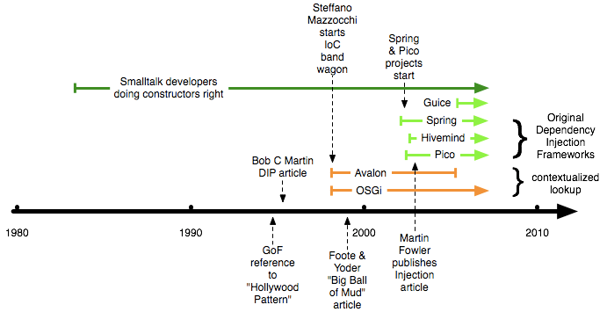
History

Slide 10
DI Containers
Java
CDI, EJB, Spring, Guice
.NET choices:
Unity, Castle Windsor, Spring.NET
Ruby
DI is integral part of the language, containers are not needed
Notes:
Java: Spring
Ruby: we don’t need no stinkin’ DI containers!

Slide 11
DI Container Rules
Don’t “new” up anything that is a dependency
Don’t new up classes that you want to create a fake in a test
Do new up entity objects
Do new up value types (e.g. String, DateTime, etc.)
Do new up Java API types (e.g. Connection)
Entity objects should not have dependencies
If you have to have static variables, isolate them behind the DI container (e.g. example in previous slide)
Mock the DI container when writing unit tests

Slide 12
DI Container
Do we really need this stuff?
No. Not at all. You could simply pass all instances to other objects manually. If you have a small application, there is no need for a DI container.
But on the other hand, frameworks give you a helping hand, managing objects:
They help you wiring up complex object relationships. You have to write no boilerplate code, to generate instances and pass them to the appropriate objects
They help you control when an object is created: you could create instances during application bootstrapping, but in some cases a lazy creation - only when needed - is better
They help you control how many instances are created: one per application lifetime or one per request (in case you are doing web-programming)

Slide 13
CDI
DI in Java EE

Slide 14
What is CDI?
Bindings are code based
Bindings are code or XML based
Type-safe DI framework (based on Seam, Guice and Spring) for Java EE
Uses javax.inject as a base API

Slide 15
Implementations, web profile
Three implementations: JBoss Weld, Apache OpenWebBeans and Resin CanDI
Only one stable at the moment – Weld, used in Glassfish and JBoss AS
JavaEE 6 has the so-called „profiles“. CDI is part of the „Web profile“
CDI implementations are not limited to application servers (with the help of extensions)
Tomcat does not fully implement the “Web profile”, but TomEE (extension of Tomcat) implements the CDI API.

Slide 16
Injection targets for Java EE
Inject into:
POJOs
Servlets
REST Services
Injection candidates:
POJOs
Factories
DAOs
…

Slide 17
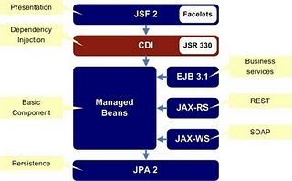
Java EE structure with CDI

Slide 18
Injection
public class OrdersBean {
@Inject private OrdersDao dao;
}
@javax.inject.Inject is used:
The „dao“ field is called „injection point“. Injection point types are:
Field
Constructor
Setter
Initializer

Slide 19
Injection points
public class OrdersBean {
@Inject private OrdersDao dao;
@Inject
public OrdersBean(OrdersDao dao){}
@Inject
public void init(OrdersDao dao) {}
@Inject
public void setOrdersDao(OrdersDao dao){}
}

Slide 20
Outcome
Writing fake implementations of dependencies only for test purposes
What we’ve achieved?
Both client and supplier are decoupled from implementation details
All dependency logic is executed at runtime and is contained in Modules
A module encapsulates all creation logic in our program
Testing & Mocking is easy – since we’re essentially using constructor injection
Side-note:
Other DI frameworks (e.g. Spring) use XML files to define dependencies
This enables changing the code’s behaviour without recompiling
But it also has its disadvantages (e.g. it’s not type safe)

Slide 21
Dependency Injection – Is it really that important?
If we want to write real units tests, then we have to isolate our units
If we want to isolate our units, then we have to use mocks
If we want to use mocks, we have to inject them somehow
But we aren’t doing it (just) for the tests!
If we use dependency injection, our code is less coupled, more modular, robust, and reusable, cohesive, cleaner and DRYer.
Remember: Testable Code => Better Code!
Unit Tests
Mock objects
Dependency
Injection

Slide 22
Case: OrderService (revisited)
Build a simple client using Guice to wire all dependencies for creating a new OnlineOrder instance.

